Slide 1
Team Jaguar

Slide 2

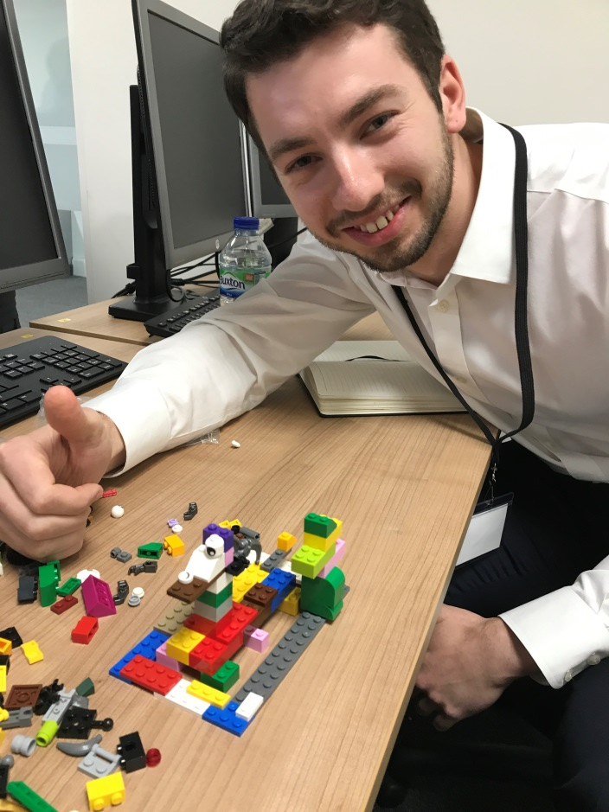
Introduction
Team compromising of 3 Developers and 4 PMO’s
Lego Team Building
Presentation of Business Case to Developers

Slide 3
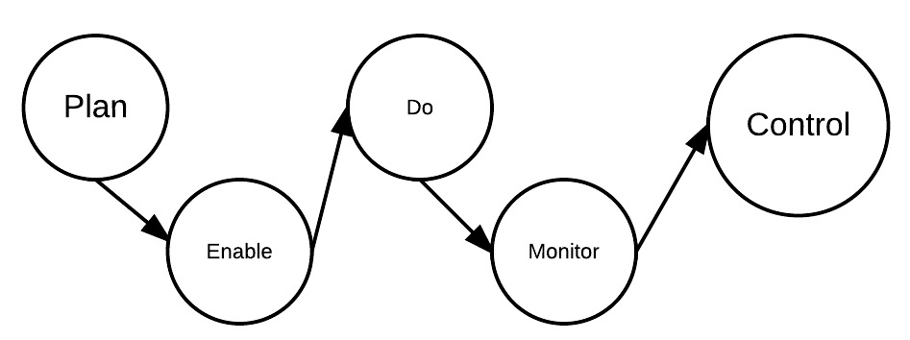
Business Activity Modeling (BAM)
Background research carried out prior to the commencement of the project
Determination of online store requirements
The functionality of the website
Control required for keeping the website upto date
Notes:
Refer to BAM on wall

Slide 4
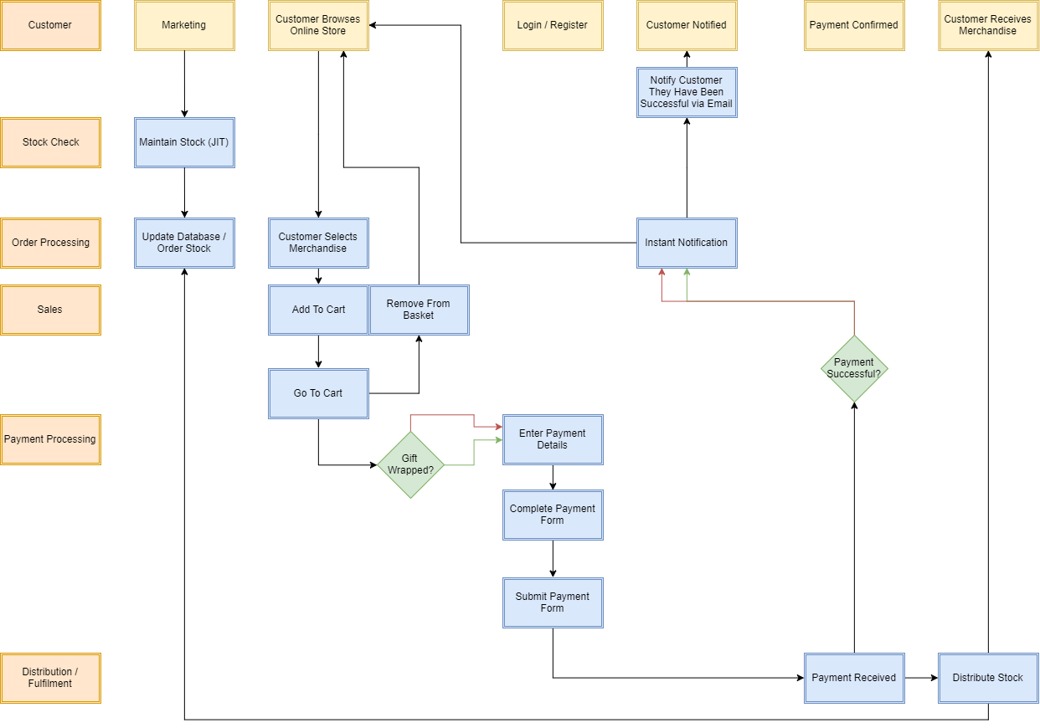
Swimlane Diagram
Collaboration with Developers
Alteration to business perspective
Allows for a clearer understanding of the process flow when ordering an item from the website

Slide 5
Project Initiation
Pre-sprint Activities
Carry out preliminary discussions
wireframe
TDD
First meeting
setting team rules
establishing definition of done
Project owner
Scrum Master

Slide 6
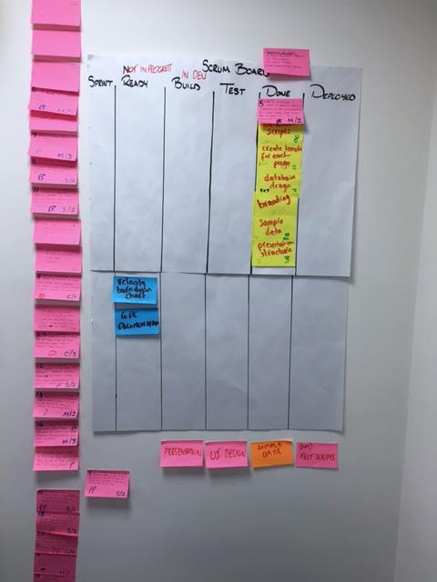
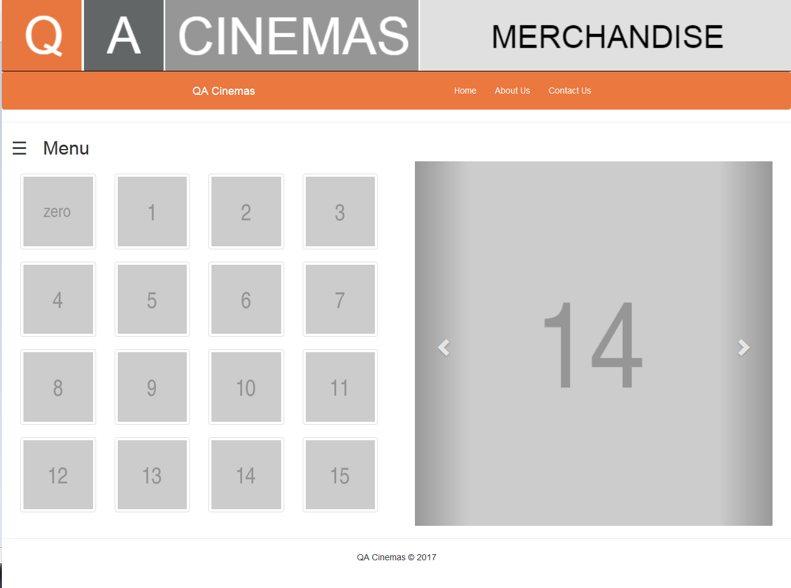
Sprint 1
Create template for each page
Presentation Structure
UI Design
Database Scripts
Sample Data
Database Design
Notes:
Success reasons:
Failure reasons:

Slide 7
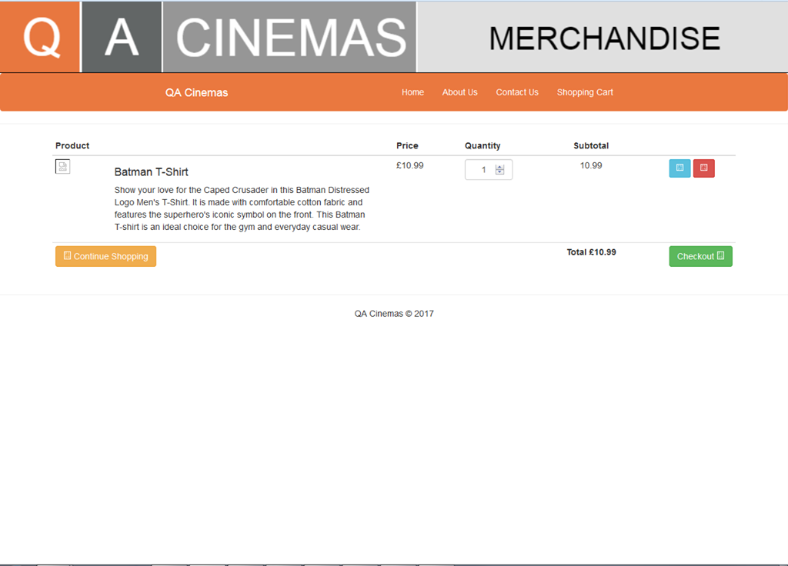
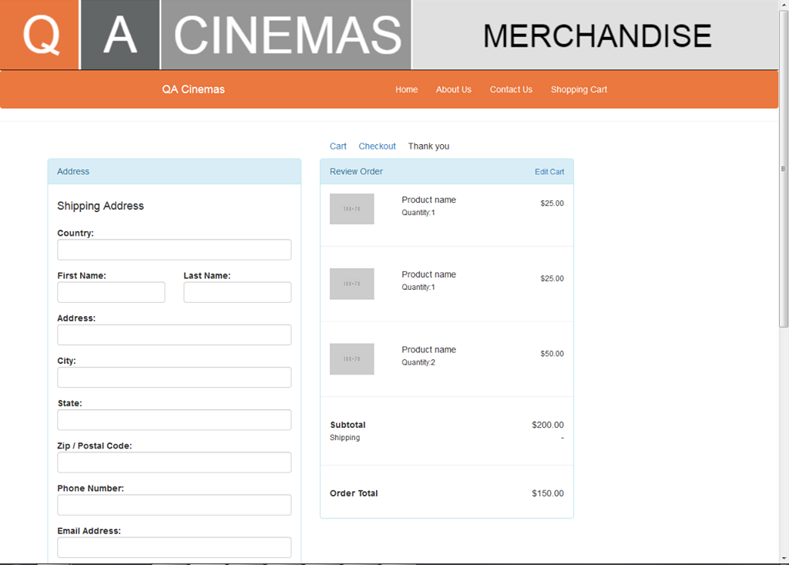
Sprint 2
Connect to Database
Design Cart Page
Checkout Page Layout
Test Scripts
Retrieve and Display Products

Slide 8
Sprint 3
Activities

Slide 9
Sprint 4
Activities

Slide 10
Final Burndown Chart

Slide 11
Navigation Through Website

Slide 12
Lessons Learned

Slide 13
Summary

